Slide 1
EOC Sample Political Cartoons For Review
U.S. History

Slide 2
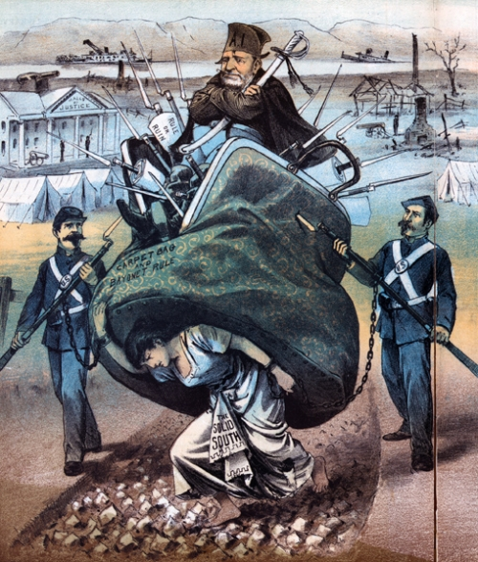
Reconstruction

Slide 3
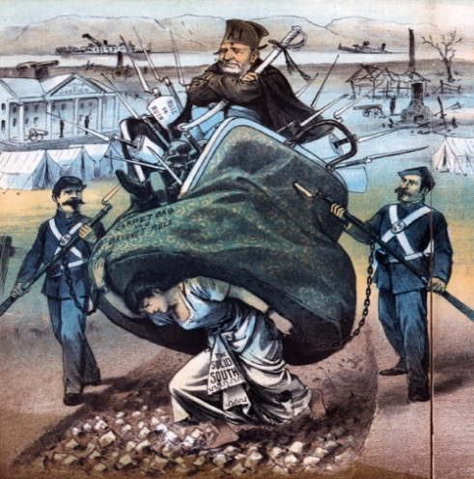
Reconstruction
This political cartoon from the period of Reconstruction depicts how Southern society was oppressed by Radical Republican policies. The main congressional action that led to the Southern viewpoint expressed in this cartoon is the military occupation of the former Confederate states from 1865 to 1877. Thus this cartoon shows that Reconstruction was a burden on the South and was forced on the South by the federal government.

Slide 4
Reconstruction
A. What U.S. President is seated atop the carpet bag?
B. What do the weapons and soldiers in the cartoon represent?
C. What is this cartoonist’s view of Reconstruction?

Slide 5
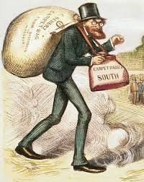
Reconstruction

Slide 6
Reconstruction
This cartoon from a Southern
Democratic newspaper depicts
German born Carl Schurz, a liberal Republican U.S. Senator from the State of Missouri who advocated legal equality for African Americans. Schurz is shown as a carpetbagger trudging down a dusty Southern road as a crowd of people watch his arrival.

Slide 7
Reconstruction
A. Is Schurz shown in a positive or negative light? How can you tell?
B. Why do you think the cartoonist chose to place the crowd of onlookers at such a great distance from Schurz?

Slide 8
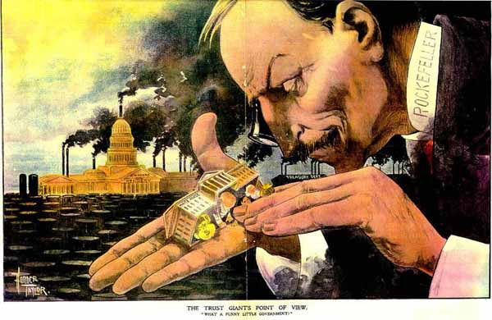
Industrial Revolution

Slide 9
Industrial Revolution
This cartoon was drawn by someone who was obviously very critical of John D. Rockefeller's policies. It was drawn during the height of Rockefeller's power and wealth. The cartoon shows Rockefeller as a giant, completely in control of the Supreme Court, as he is apparently putting bags of money inside the building. The background shows the US Capitol Building with smoke stacks on it, surrounded by a huge field of oil drums. Rockefeller had much government influence, being the richest man in the world at the time. His use of horizontal integration gave him an oil monopoly, which would have given him enough money to make sure his supporters would be elected to powerful offices.

Slide 10
Industrial Revolution
The cartoon was obviously designed for people that weren't rich. The poor and middle class Americans who felt the economic strain of Rockefeller's monopoly would get the full effect of the cartoon. The cartoon shows how Rockefeller's business practices are not in the best interest of anyone other than himself. The main idea is that Rockefeller has complete control over the US government. The cartoon would serve to make people who were previously unaware of Rockefeller's practices angry with him, and also affirm the suspicions of those who had questioned him already.

Slide 11
Industrial Revolution
A. Who is the man pictured in the political cartoon?
B. List what symbols you see in the political cartoon
U.S. ______________ building
Factories and factory smoke stacks (pollution)
The U.S. _______Court Building
C. Why is he putting bags of money in the Supreme Court Building?
D. What is the meaning of this Political Cartoon? E. How does the artist feel about the person depicted in the political cartoon?

Slide 12
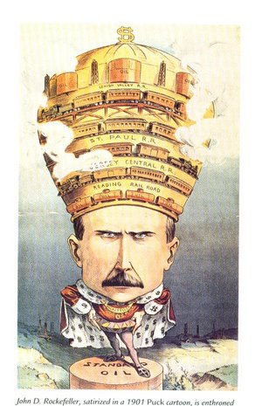
Industrial Revolution

Slide 13
Industrial Revolution
John D. Rockefeller’s Standard Oil was one of the biggest and most controversial “big businesses” of the post-Civil War industrial era. Rockefeller entered the oil refining business in 1863 and though highly competitive practices, he began to merge with or drive out of business most of his competitors. Though this process of horizontal combination, by the 1880s the Standard Oil Trust controlled 90% of the oil refining business in the U.S. Because of the size of his enterprise, Rockefeller was able to dictate favorable shipping terms from the railroads, the other major big businesses of his day—a sign of the economic power of Standard Oil.

Slide 14
Industrial Revolution
Note how in this cartoon Rockefeller’s crown is labeled with the names of rail lines that he effectively controlled. By keeping transportation prices low, Standard Oil delivered less-expensive oil to market, pricing out much of the competition. Once the competition was gone in particular regions, Rockefeller could resume higher prices. With Standard Oil’s size and wealth, no oil company had any hope of outlasting Standard Oil in such a situation.

Slide 15
Industrial Revolution
A. Who is the man depicted in this political cartoon?
B. What is he wearing on his head and what does it indicate about him?
C. By being able to dictate favorable shipping terms, Standard Oil Company was able to do what?
D. What did this result in for Standard Oil Company?

Slide 16
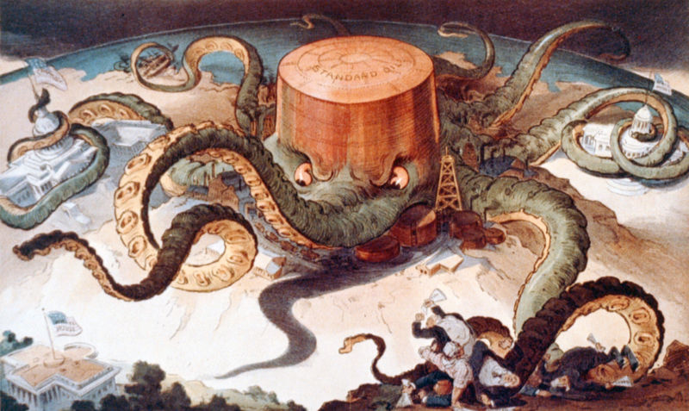
Industrial Revolution

Slide 17
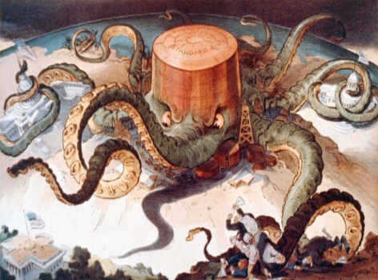
Industrial Revolution
The cartoon “The Standard Oil Octopus”, and other similar ones that were seen with the rise of Rockefeller’s Standard Oil Trust, accurately represents the differing viewpoints of the wealthy “captains of industry” and those of average working class Americans during the Second Industrial Revolution. This new class of wealthy industrialists truly believed in the all-American image of opportunity for the common man and social Darwinism, that is, survival of the fittest. The only reason that they could fully clear their moral conscience for taking advantage of workers and consumers to make profit was by convincing themselves that they had the ultimate right to engage in such practices.

Slide 18
Industrial Revolution
Clearly, Americans who were not lucky enough to part of such an elite class were severely dissatisfied by the industrialists’ use of their corporate power. The octopus’ head is representative of the central trust of the Standard Oil Company, composed of a board of trustees headed by Rockefeller. The tentacles represent the way that the trust controlled every aspect of every branch of the Standard Oil Company, across the entire nation. Cartoons such as these led to the widespread distrust of industrialist methods, as the tentacles surrounding the governmental buildings indicate Rockefeller’s use of bribery to influence Congressmen and other officials to prevent the passing of anti-trust and anti-monopoly laws.

Slide 19
Industrial Revolution
Once such cartoonists revealed to Americans this ultimate corruption in the governmental system, the ruthlessness of industrialists such as Rockefeller became painfully clear and they became an enemy of the public, constantly portrayed in a negative light, causing Americans to have mistrust in corporate systems as a whole. Regardless of how Rockefeller justified and rationalized his methods, his reasoning would not be heard by American workers and consumers, who saw only the unjust consequences of his trusts.

Slide 20
Industrial Revolution
A. List all the symbols that you see in the political cartoon.
B. What or who does the octopus represent?
C. How did the wealthy industrial feel about taking advantage of workers and consumers?
D. How did American’s feel about trust and big business?

Slide 21
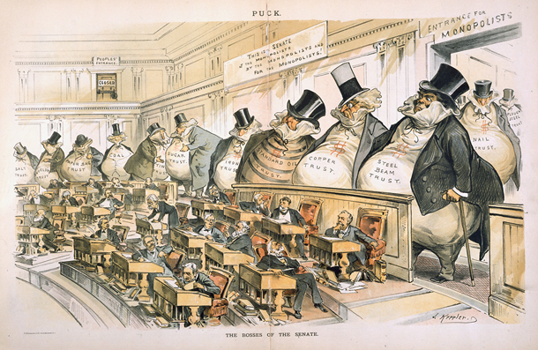
Gilded Age

Slide 22

Gilded Age
Drawn by Joseph Keppler - a prominent Populist cartoonist for Puck, this 1889 political cartoon attracts attention to the gross power of industrial lobbies over the Senate. Emphasized in "The Bosses of the Senate", industrialists were learning to win their monetary games through the submissive hands of government, specifically the Senate. During this era, much of industry's monetary success sprung from coalitions formed by competing corporations. In order to diminish the hindrance of a free market's price fluctuations (as competition favored decreasing prices), many industries formed internal alliances amongst their corporations to coordinate prices and resource allocations. From this, the monopolists benefited, but the wider public was left behind. Senators, shown here as small but happy, were inclined to play puppets for the fat money sacks of business-backed trusts both because big business provided the overwhelming majority of government tax revenue and industry financed many senator's political assurances. Drawn before the first anti-monopoly law - the Sherman Anti-Trust Law, this cartoon was influenced by Keppler's contemporary perception that congress was subject to the will money sacks of trusts more than it was to the voice of the people. Capital had become the new capitol.

Slide 23
Gilded Age
Ensconced by the epitaph "This Senate is of the Monopolist, by the Monopolist, and for the Monopolist", the Senate announces its purpose is to uphold the Monopolist (as opposed to the People). This inscription contradicts the Constitution, and was meant to reveal that the government was moving away from its foundational purpose. Also predominating this image, the huge size of corporate lobbies is contrasted to the small stature of the senators. This disparity, between the pithiness of the legislators and the towering gaze of the industrialists, emphasizes how it was industrialist power that truly occupied the Senate's seats of power. Labeled "Steel Beam Trust", "Copper Trust", "Standard Oil Trust" and other resource "trusts", the imposing figures of corporate trusts reference lobbying trusts created to congressionally clear the way for economic success for corporations such as Carnegie's US Steel, JP Morgan's Railroads, and Rockefeller's Standard Oil. The diminutive door in the second story gallery's far corner is labeled "Public Entrance", whereas the grand aperture to the lower right is titled "Entrance for Monopolists". Trusts' accessibility to the Senate floor is broad and open, while the public's voice is locked out of consideration entirely. The public voice had been expelled by the weight of preeminent monopolies and their financial persuasion.

Slide 24
Gilded Age
A. Why do you think the businessmen are drawn so large?
B. What are some of the trust that the “fat cats” represent in the political cartoon?
C. What legislative body is seated in this political cartoon?
D. Why would the Monopolists Trust have a larger open door to the Senate floor and the American public have a second floor door?

Slide 25
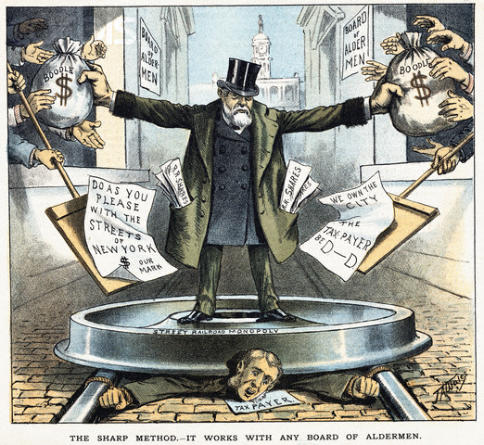
Gilded Age

Slide 26
Gilded Age
In the 1880’s, Jacob Sharp expanded his New York City streetcar business by bribing New York city alderman and other government officials.

Slide 27
Gilded Age
A. What symbols represent the corruption of city government?
B. According to the cartoonist, what is the effect of the street railroad monopoly on the taxpayer?
C. How does the political cartoon illustrate the problems with many city governments during the Gilded Age period?

Slide 28
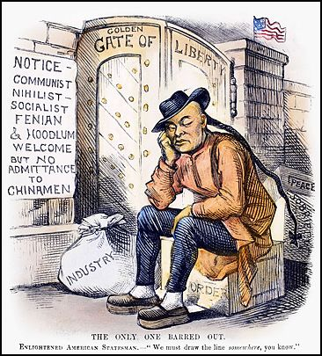
Immigration

Slide 29
Immigration
The cartoon pictures above displays the racist cruelty expressed in the Chinese Exclusion act. The ‘allow list’ seems hyperbolic but when though about is true. Communists, Socialists, etc… were all allowed to enter into the USA but the Chinese were forbidden because they were stereotyped to only stay for a few years then leave with the American money they made. The cartoon also emphasizes the American virtues of freedom and liberty on the gate and America as a melting pot. The act was very controversial because it was actually based on racial discriminatory stereotypes which went against much of which America was about. The Chinese worked on the railroads for long periods of time and many were dubbed as all unskilled laborers who were stealing jobs from other Americans then moving out of the country. This stereotype was the basis for the Chinese Exclusion Act. Some, with great difficulty were able to gain access and immigrate to the USA with permission from the government, but this was near impossible to do. The cartoon displays how the Chinese were unfairly locked out of American because of their race and were unable to obtain citizenship.

Slide 30
Immigration
A. What group was denied entry? Why?
B. What group or groups were welcome? Why?
C. What country is located on the other side of the “Golden Gate of Liberty”?
How do you know
this?

Slide 31
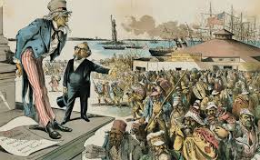
Immigration

Slide 32
Immigration
The political cartoon “Where the Blame Lies” by Grant E .Hamilton is an illustration of the view of immigrants that many American citizens in the late 19th century held. It was originally published in Judge on April 4th 1891 in New York. The author, Grant E. Hamilton was one of the most well-known cartoon artists of the time period. “Where the Blame Lies” shows Uncle Sam looking down disapprovingly upon recently arriving Immigrants to America. Uncle Sam represents the whole of America as a personification of American values. The cartoon maker obviously believes that the values of America would not be upheld by many of these immigrants that he portrays in his cartoon. He attempts to provide what he believes is a view of immigrants that is shared by the average man.

Slide 33
Immigration
In the late 19th century, the number of immigrants to America reached new heights. These new immigrants were different from previous immigrants. The previous immigrants had been from the more traditionally democratic states of Western Europe while the numerous new immigrants were mainly from Eastern Europe. They came from Eastern European countries, ones who generally had a history of being either a dictatorship or a socialist regime. Their political views were at many times contrary to many of the American people and this scared the Americans because they believed it could be possible that the sheer number of immigrants could eventually overwhelm them. This is the reason that in the cartoon one of the men is labeled German Socialist and another is labeled Russian anarchist. Not only does the cartoon illustrate the fear felt by the common man toward political ends, but also toward his fear for his job.

Slide 34
Immigration
Many of the immigrants were severally poor and therefore willing to work for much lower wages. This threatened the job security of many of these Americans and eventually became part of the leading charge for advocates of immigration reform. This cartoon advocates for immigration reform because it paints a picture of the immigrants that would be left out in a reformation as criminals or paupers or people with extremely different political beliefs. Hamilton’s charge against immigration is mainly intended for the common man, and seeks to make him think that immigrants are different from him in both political and moral forms and also that they are dangerous to him because they undermine his job security. It is a very important cartoon because it provides a glimpse into the ideology behind the beginning of immigration reform. The name “Where the Blame Lies” implies that the blame of many issues lies directly upon the back of the many newly arrived immigrants to the American continent.

Slide 35
Immigration
Which political issue does this cartoon illustrate?
A. the effects of unchecked immigration
B. the health effects of the factory system
C. the effects of low American wages
D. the effects of prohibiting alcohol on society

Slide 36
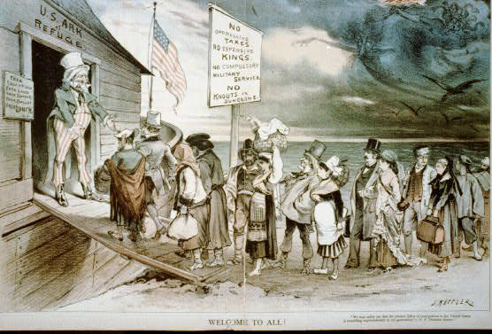
Immigration

Slide 37
Immigration
In the first cartoon, we see Uncle Sam extending his arms to welcome a group of immigrants. While the origins of these immigrants is not specific, we can see that they are escaping "demons" such as war (here, students might also list famine, poverty, and political/religious oppression). Uncle Sam is standing onboard the "U.S. Ark of Refuge." To the left is a sign that reads, "free education, free land, free speech, free ballot, free lunch," a commentary on all that the United States has to offer. Above the immigrants reads another sign: "no oppressive taxes, no expensive kings, no compulsory military service, no knouts or dungeons." For those wondering, a knout is a type of whip with multiple tips. Finally, students might also point out that the immigrants appear rather well-kept.

Slide 38
Immigration
The cartoon Welcome to All! expresses new immigrants' positive outlook on starting a new life in America, and it depicts the country as a land of freedom and opportunity. In the image, Uncle Sam, a representative of America, welcomes people from various nations with open arms. He and the U.S. Ark of Refuge mirror Noah and the ark. Uncle Sam is shown leading the immigrants away from the darkness of their home countries and into the "U.S. Ark of Refuge." The author of the cartoon, Austrian-born Joseph Keppler, was an immigrant himself. Upon arriving to the United States, he founded Puck, America's first successful humor magazine, which became wildly popular with a large audience. Keppler became highly influential. His personal success allowed him to view the American Dream in a positive way, which is indicated in the cartoon. Welcome to All! was published in Puck in 1880, around the time when the country witnessed a tremendous wave of immigrants from southern and eastern Europe. There were several reasons for immigrants wanting to come to America, including persecution and widespread poverty in their mother country. Although most immigrants faced grim reality and a hard new life, this cartoon focuses on conveying the initial optimistic beliefs of new immigrants wanting to begin a new life in the U.S.

Slide 39
Immigration
A. What are the five (5) benefits that immigrants might receive in America?
B. What is Uncle Sam doing atop the plank?
C. What attitude about immigration does this cartoon present?

Slide 40
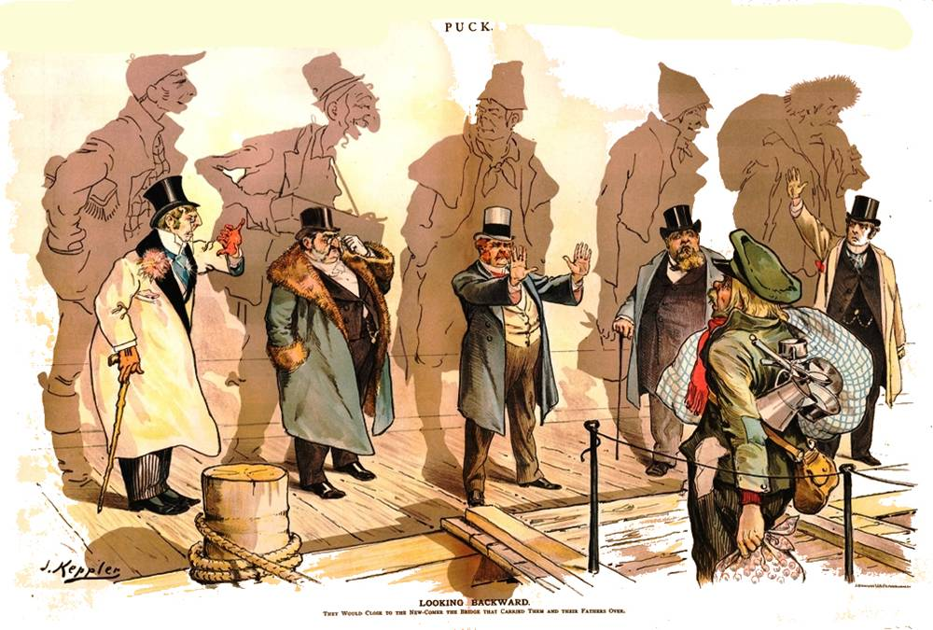
Immigration

Slide 41
Immigration
In the mid-1880s the number of immigrants to the United States from
northern and Western Europe declined sharply. At the same time, the number of immigrants from southern and eastern Europe greatly increased. The changing pattern of immigration concerned many Americans who believed the newcomers represented, in the language of the time, inferior “races” of Europeans. The new immigrants were overwhelmingly non-Protestant Christians—either Roman Catholic or Orthodox—or Jewish and thus not Christian at all, which disturbed many Protestant Americans. This cartoon makes an ironic commentary on the children of immigrants rejecting the arrival of new immigrants.

Slide 42
Immigration
A. What groups of people are represented in this political cartoon?
B. What point was the artist trying to make?
C. What are the men doing on the dock?
D. Why are they doing this?
E. What do the shadows represent?
F. What attitude about immigration does the cartoon now present?

Slide 43
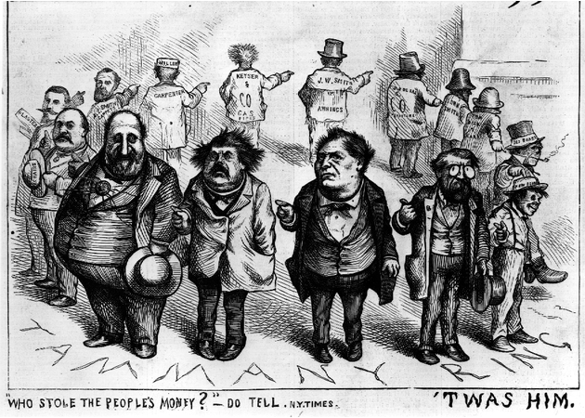
Gilded Age

Slide 44
Gilded Age
The very famous political cartoonist Thomas Nast always seemed to have a personal hatred toward William Macy “Boss” Tweed. When many major newspaper publishers started to expose the massive corruption by the members of Tammany Hall and Boss Tweed, Thomas Nast intensified his assault against his adversary. Nast worked for the highly acclaimed newspaper of the time called Harper’s Weekly, who along with the other major newspaper publishers, began a relentless assault on Tweed and his assistants. This cartoon was published in 1871 and this time period is important, because it held the primary accounts of Tweed’s illegal actions which further promoted the questioning of specific acts committed by Tammany Hall’s higher officials found in the Tweed Ring. This material specifically addresses the fact that no one person found in Tweed Ring would take the blame for the corrupt nature of his political machine. Tammany Hall was a highly organized group of men following positions, up to the highest role of “boss” of the machine.

Slide 45
Gilded Age
The leaders of the machine influenced new immigrants to vote in their favor, bolstering their position in the city government. Upon the acquisition of a puppet in the city government, the boss of Tammany Hall, Tweed, and his group of high officials, the Tweed Ring, began acquiring funds for certain city projects. Often illegal, the group’s actions could never be traced to one person, often making it hard to acknowledge, let alone stop. The understanding of Nast’s depiction of Tweed Ring is made much more simple upon understanding the shady, extralegal acts performed by the entire group; rather than just one man. One outstanding symbol found in this cartoon is the obvious image of every man in the ring pointing to the next. This supports the idea that Nast attempted to display the lack of personal responsibility shared by all the men in this portrayal. This cartoon is very important, because it served as the quintessential image of the public’s view of the Tammany Ring, until emotions toward the machine turned sour. After the massive assault on this political machine made by various newspaper publishers, this cartoon served as the visual basis, upon which all future ideas of the Tweed Ring were made, and to this day, the image serves as a visual metaphor for the common phrase, “Passing the buck.”

Slide 46
Gilded Age
A. How does the cartoon illustrate the idea of pass-the-buck?
B. Which figure is most likely Boss Tweed? Why would you think this?
C. How does this cartoon illustrate a political machine at work?

Slide 47
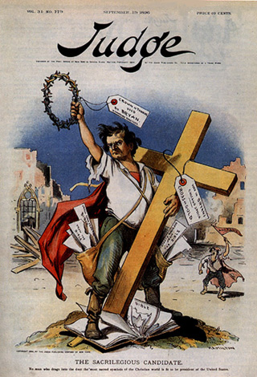
Populism

Slide 48
Populism
This political cartoon depicting presidential candidate William J. Bryan was published on September 19, 1896. It shows Bryan holding the cross and is entitled “The Sacrilegious Candidate.” Bryan was known as a huge advocate of separation of church and state. He was a member of the Democratic Party. He also gave public speeches out of the back of railroad cars, which was very uncommon in that time. He received criticism and praise for this. This cartoon targets Republican and Gold Democrats, both of whom were rivals of Bryan.

Slide 49
Populism
The point that this cartoon is trying to portray is that, Bryan is disrespecting the cross by being so against the joining of church and state. His most memorable speech was without a doubt the “Cross of Gold” speech in which Bryan calls to attention the silver and gold issue brought up by all the new silver and gold ore being mined and the decision whether or not to make a floating currency, or one based on the gold standard. What made this speech infamous was Bryan’s heavy reliance on religious symbolism. Many saw this as sacrilegious because many truly believed that politics was the trade of cheats and liars, both wholly unholy things.

Slide 50
Populism
ANSWER THE QUESTION BELOW:
William Jennings Bryan was the Democratic candidate for president in 1896 on a platform illustrated in the cartoon shown above. Bryan’s campaign positions on economic issues were very close to which of the following political groups of Bryan's period? A. Republican Party B. Populist Party C. Progressive Party D. Prohibitionist Party

Slide 51
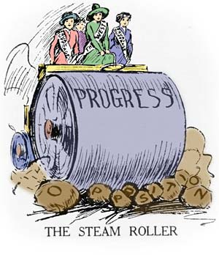
Progressive Movement

Slide 52
Progressive Movement
A 1917 political cartoon depicting four women supporting suffrage on a steamroller crushing rocks labeled "opposition". By March of 1917, an energized women’s suffrage movement was in the last stages of its push to win the right to vote for all women in the United States. Women began winning voting rights in some western states in the late 1800s. The reform movement known as “Progressivism” further boosted the drive for female suffrage in the early 1900s. The effective roles women played during World War I may have finally pushed President Woodrow Wilson in 1917 to agree to back a Constitutional amendment guaranteeing women the right to vote. The 19th amendment was passed in 1919 and sent to the states. The states ratified it in 1920.

Slide 53
Progressive Movement
A. What is the main point of this cartoon?
B. Why is one women in the cartoon wearing a banner labeled “West”?
C. What do the large rocks represent?

Slide 54
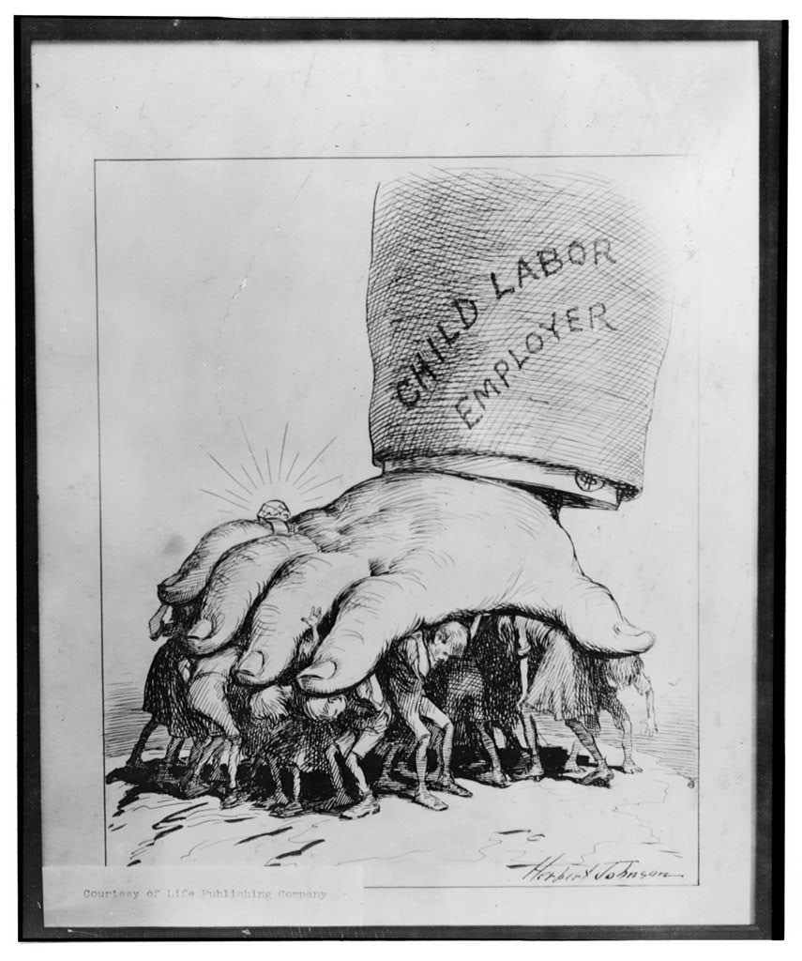
Progressive Movement

Slide 55
Progressive Movement
Child labor existed throughout American history. As the nation industrialized, child labor moved from the farm to the factory. Children were seen as cheaper and easy to control. They were hired in large numbers to work in mines and factories, often in extremely unhealthy and dangerous conditions. In the early 1900s, labor unions and other national reform organizations began to seek legislation regulating or limiting child labor and promoting free, compulsory education as a substitute

Slide 56
Progressive Movement
A. Who is the group being crushed by the giant hand?
B. Who or what does the giant arm and hand represent?
C. What major issue is this cartoon concerned with?
D. How do the distortions help the cartoon make its point?

Slide 57
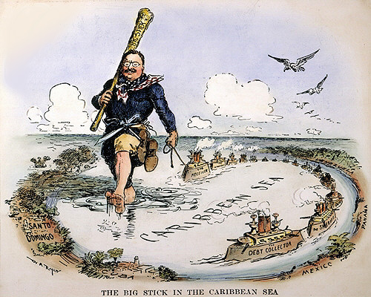
Imperialism

Slide 58
Imperialism
President Theodore Roosevelt enforcing his concept of the Monroe Doctrine by having a U.S. naval flotilla steam from one Caribbean port to another.
The cartoon satirizes the expansion of the Monroe Doctrine by depicting the giant Roosevelt striding toward Panama, Cuba, Santo Domingo and Mexico. Roosevelt had famously summarized his attitude toward foreign policy with the phrase "Speak softly, and carry a big stick." Roosevelt believed that the United States should intervene in the affairs of other countries in the Western Hemisphere, including military intervention in Latin American countries.

Slide 59
Imperialism
A. Why does this cartoon depict Theodore Roosevelt carrying his “Big Stick” through the Caribbean?

Slide 60
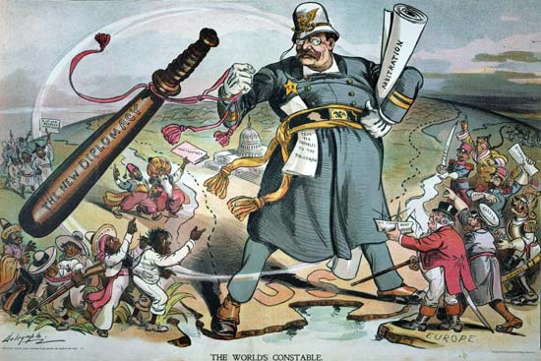
Imperialism

Slide 61
Imperialism
Building the Panama Canal was only one of President Roosevelt's goals. He also wanted to make sure that it would always be safe for American ships to use the Panama Canal. Roosevelt thought that to do this, the United States must guard the peace in Latin America. At that time, many countries in Latin America had problems. And some of them owed large sums of money to European countries. President Roosevelt did not want any European country to send soldiers to collect this money. To avoid this possibility, President Roosevelt added a new part to the Monroe Doctrine. The president said that if any Latin American country was unable to keep order or to pay its debts, the United States would step in and manage that country's affairs. If a situation arose in the Western Hemisphere that required "international police power," he said, the United States would do the job. This is called the Roosevelt Corollary to the Monroe Doctrine. The Roosevelt Corollary changed the role of the U.S. in the western hemisphere. The Monroe Doctrine had made us the protector of that area. The Roosevelt Corollary made us its "policeman."

Slide 62
Imperialism
A. What is the meaning of the paper tucked under Theodore Roosevelt’s left arm marked “Arbitration”?
B. Why does the night stick have the words “The New Diplomacy” printed on it?
C. What building is shown in the cartoon?
D. How does the cartoonist use stereotypes to state his message? What groups are stereotyped?
E. Is this cartoon supportive or critical of Theodore Roosevelt?

Slide 63
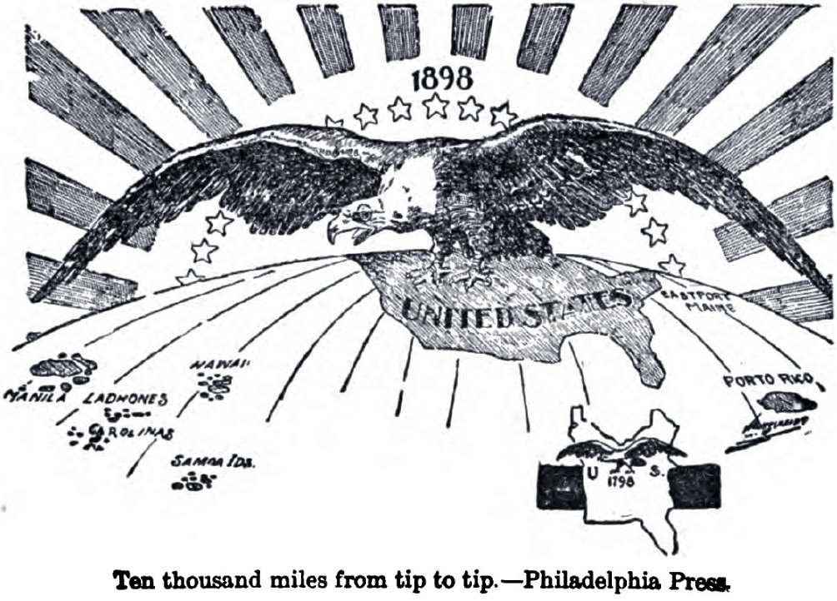
Imperialism

Slide 64

Imperialism
This political cartoon refers to the extension of United States domination (symbolized by a bald eagle) from Puerto Rico to the Philippines. The cartoon contrasts this with a map of the smaller United States of one hundred years earlier in 1798.

Slide 65
Imperialism
A. According to this cartoon, how did the U.S. change from 1798 to 1898?
B. What is the role of “Manifest Destiny” in this cartoon?
C. In your opinion, is the cartoonist showing the imperialist point of view or the isolationist point of view? Explain.

Slide 66
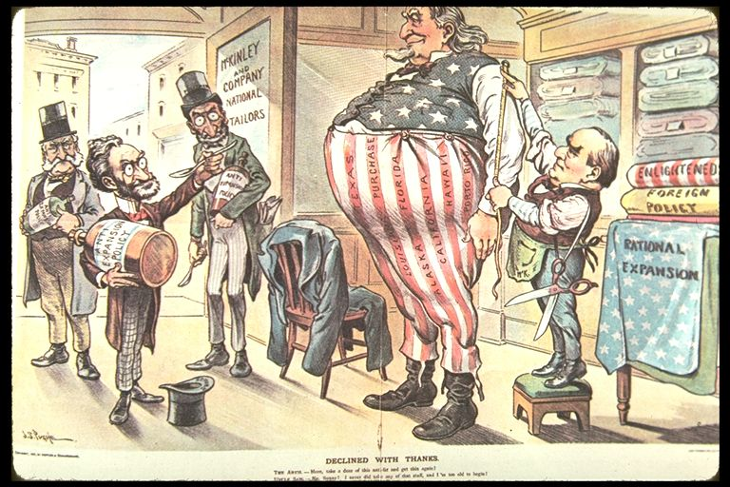
Imperialism

Slide 67
Imperialism
From the 5th of September 1900 this political cartoon illustrates a huge Uncle Sam getting a new outfit made at the "McKinley and Company National Tailors" with President McKinley taking the measurements. Carl Schurz, Joseph Pulitzer, and Oswald Ottendorfer stand inside the entrance to the shop and Schurz is offering Uncle Sam a spoonful of "Anti-Expansion Policy" medicine, a bottle of which each is carrying. On the right are bolts of cloth labeled "Enlightened Foreign Policy" and "Rational Expansion." The strips on Uncle Sam's trousers are labeled "Texas, Louisiana Purchase, Alaska, Florida, California, Hawaii, [and] Porto Rico." Caption: The Antis. Here, take a dose of this anti-fat and get slim again! Uncle Sam No, Sonny!, I never did take any of that stuff, and I'm too old to begin!

Slide 68
Imperialism
A. Who is the man fitting Uncle Sam for this new clothing (check the sign on the door for a clue)?
B. What does this say about the man’s policies?
C. What is the message of this cartoon? What is the cartoonist saying about the U.S.?
D. What had been the result of the U.S. growing throughout the years?
E. Based upon the message of this cartoonist, is this cartoonist in favor or opposed to U.S. imperialism? Explain.

Slide 69
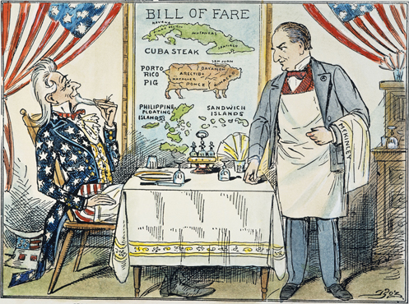
Imperialism

Slide 70
Imperialism
This Political cartoon from @1900 is showing the President of the United States waiting for Uncle Sam to place an order. The menu lists various territories that might appeal to the diner's appetite.

Slide 71
Imperialism
A. Who is the waiter (president) taking Uncle Sam’s order for dinner?
B. Which nations are offered on this bill of fare(the menu)?
C. In which of these nations did the U.S. ultimately pursue its interest?
D. What seems to be Uncle Sam’s attitude toward the offerings on the menu?

Slide 72
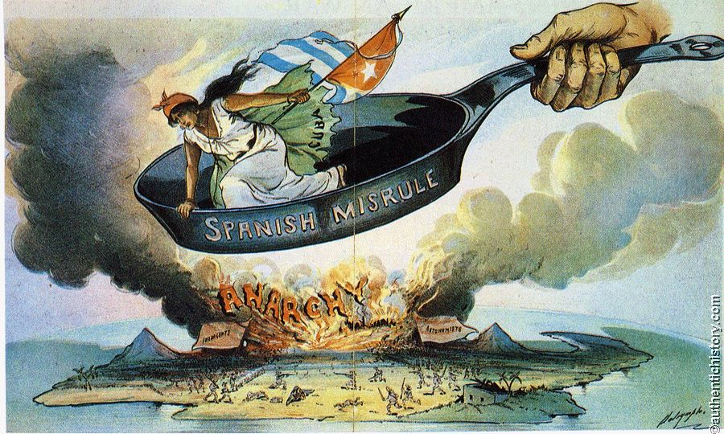
Imperialism

Slide 73
Imperialism
This political cartoon is trying to spread support for U.S. involvement in Cuba. The caption reads "The duty of the hour; - to save her not only from Spain, but from a worse fate". The symbol of the frying pan "Spanish Misrule" paints Spain as the antagonist that is harming Cuba, represented by the woman held over the fire of anarchy. The subject of this cartoon is that the U.S. should get involved as it is its "duty".

Slide 74
Imperialism
A. Who or what does the women in the frying pan represent? How do you know that?
B. Spain in this cartoon is painted as an antagonist. What is an antagonist?
C. How is Spain “Misruling” the island of Cuba?
D. What does the cartoonist believe the U.S. should do or should not do about the issue of Spanish rule over the island of Cuba?

Slide 75
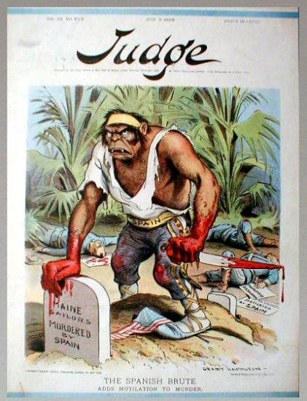
Imperialism

Slide 76
Imperialism
This political cartoon depicts a fanged ape represented as a Spaniard, standing over the grave of the U.S. soldiers murdered by Spain. This cartoon was released after the sinking of the U.S.S Maine battleship which exploded in Havana Harbor. Although the most practical reason for the accident was improperly stored gunpowder, Americans quickly blamed the misfortune on Spain as an excuse to go to war. The picture depicts an ape which symbolizes that the Spaniards were inhumane and incompetent. The ape is holding a knife that is dripping with U.S. soldiers' blood, and it is stepping on an American flag which indicates that the Spaniards disrespect our country.

Slide 77
Imperialism
A. What or who does the tombstone represent?
B. According to this cartoon, who did the media blame for the sinking of the U.S. Maine?
C. How did the media portray the Spanish in this cartoon?

Slide 78
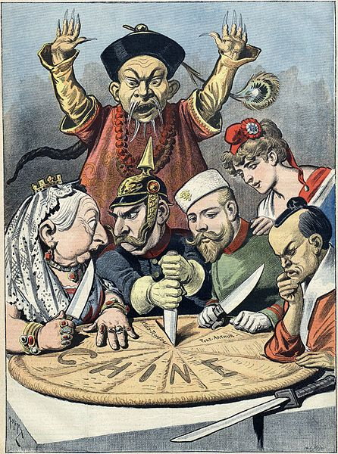
Imperialism

Slide 79
Imperialism
This is a French political cartoon from the late 1890s. A pie represents "Chine" (French for China) and is being divided between caricatures of Queen Victoria of the United Kingdom, William II of Germany (who is squabbling with Queen Victoria over a borderland piece, whilst thrusting a knife into the pie to signify aggressive German intentions), Nicholas II of Russia, who is eyeing a particular piece, the French Marianne (who is diplomatically shown as not participating in the carving, and is depicted as close to Nicholas II, as a reminder of the Franco-Russian Alliance), and the Meiji Emperor of Japan, carefully contemplating which pieces to take. A stereotypical Qing official throws up his hands to try and stop them, but is powerless. It is meant to be a figurative representation of the Imperialist tendencies of these nations towards China during the decade.

Slide 80
Imperialism
A. What is the general feeling of the Chinese toward the Spheres of Influence in this cartoon?
B. Who are some of the leaders seated at the table and what nations do they represent?
C. What are they in the act of doing?
D. Why would they be doing this?
E. What world power (nation) is left out of this cartoon picture? Why?

Slide 81
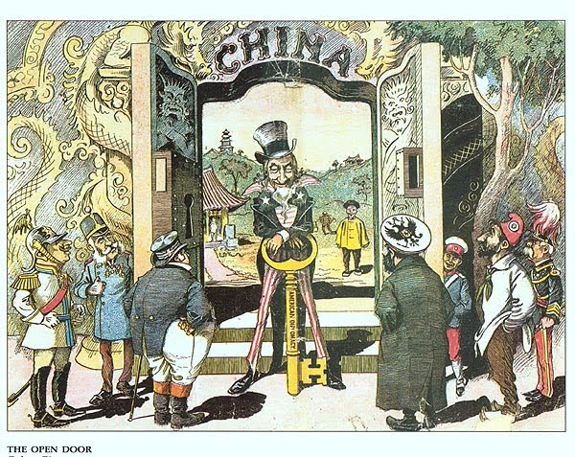
Imperialism

Slide 82
Imperialism
This editorial political cartoon is a very concise portrayal of the Open Door Policy created by John Hay. The cartoon illustrates Uncle Sam (America) holding the key which "opened the door" of trade to China with the world. Standing outside of the door are members of all of the countries who held spheres of influence in China at the time who would later partake in the large amounts of trade. The opening of the door to China to the rest of the world is clearly accurately portrayed by this drawing.

Slide 83
Imperialism
A. Who is the figure standing at the door? What does he represent?
B. Who are the other figures standing around the door, and what do they represent?
C. What else do you notice in this cartoon (any important objects, the size of things, words, etc.)
D. What is the meaning or message of this cartoon?

Slide 84
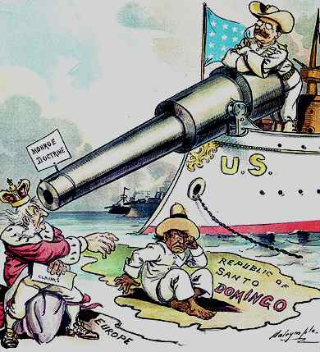
Imperialism

Slide 85
Imperialism
A @1906 Political cartoon depicting Theodore Roosevelt using the Monroe Doctrine to keep European powers out of the Dominican Republic.
In 1823, President James Monroe passed the Monroe Doctrine. The Monroe Doctrine was basically a message to the European powers telling them to stay out of the Western Hemisphere. The Doctrine made it clear that European colonization and intervention in the Americas would no longer be tolerated. In 1904, Roosevelt introduced his corollary to the Doctrine, in which he introduced "preventive intervention". Roosevelt described preventive intervention as intervening with Latin American countries in order to prevent European intervention. He used then revised doctrine to justify tariff collection in the Dominican Republic and an American presence in other Latin American and Caribbean countries

Slide 86
Imperialism
Create and answer (4) four questions for this political cartoon:
A.
B.
C.
D.

Slide 87
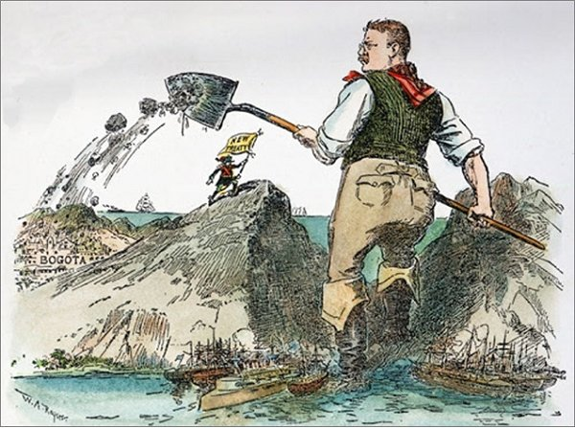
Imperialism

Slide 88
Imperialism
When Roosevelt wanted something he got it. In this sense, he was like a child. Roosevelt wanted to build the Panama Canal, and when the Colombian government refused to give him a 100 year lease on Panama for 10 million dollars he resorted to underhanded dealings. He sent money to Panamanian mercenaries to fund a revolt against Colombia. When Panama won independence from Columbia they signed a treaty granting the U.S. construction of the canal. All this really explains why the cartoonist depicts Roosevelt dumping dirt on Colombia.

Slide 89
Imperialism
A. What does the flag “New Territory” refer to?
B. What do the ships in the foreground represent?
C. What does the image of Theodore Roosevelt slinging dirt on Bogota symbolize?

Slide 90
Imperialism
The Hay-Bunau-Varilla Treaty
Increased sea trade; U.S. businesses desire for more global trade; also, the United States naval presence during 1903 Panamanian revolution
“Big Stick” diplomacy; Roosevelt’s indifference to other nation’s sovereignty

Slide 91
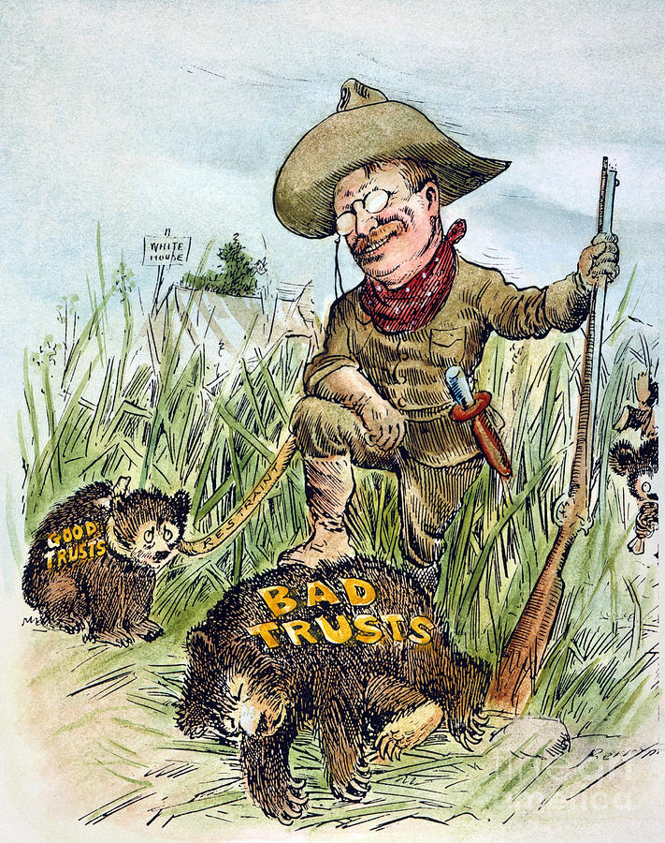
Progressive Movement

Slide 92
Progressive Movement
Political cartoon from @1909 showing President Theodore Roosevelt slaying those trust he considered “bad” for the public interest while restraining those whose business practices he considered “good” for the country. This earned him the nickname “Trustbuster”. The cartoon is a knock off of his famous black bear hunt in Mississippi in which he refused to kill a black bear that had been captured and tied-up to a tree.

Slide 93
Progressive Movement
A. Why is Theodore Roosevelt dressed that way in the cartoon?
B. What is the purpose of the bears being labeled different things?
B. What is the overall message of this cartoon?

Slide 94
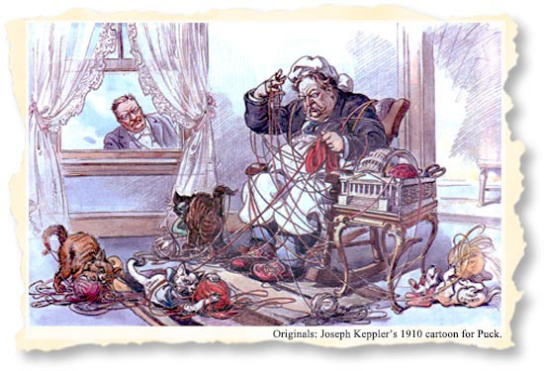
Progressive Movement

Slide 95
Progressive Movement
President Taft followed President Theodore Roosevelt in the White House. President Roosevelt looks on as President Taft is entangled in troubles. For example, Taft took a stronger stance against trusts, supported government control over certain industries, encouraged Congress to propose a federal income tax, and did not lower tariffs as much as Roosevelt wished.
Illustration shows President Taft sitting in a rocking chair, tangled in yarn from balls labeled "Conservation, Rail Road Legislation, Postal Savings Tax, Income Tax, [and] Corporation Tax" that have fallen onto the floor and are the playthings of three cats labeled "The House, Senate, [and] The Cabinet" and a dog labeled "The Courts"; one ball of yarn labeled "My Policies" remains in a box shaped like the U.S. Capitol. Theodore Roosevelt is watching, disapprovingly, from a window on the side of the room.

Slide 96
Progressive Movement
A. What details in the political cartoon illustrate Taft’s troubles?
B. What does the cartoon suggest about Roosevelt’s reaction to Taft’s situation?
C. What 1892 political party had the following goals: a federal income tax and government ownership of railroads?

Slide 97
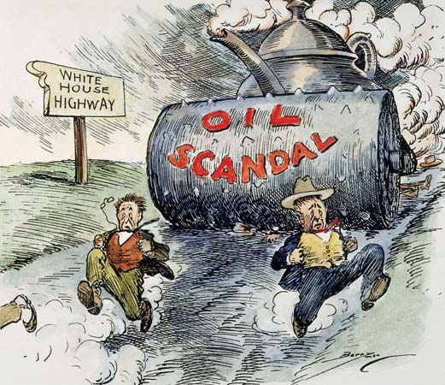
The 1920’s

Slide 98
The 1920’s
The Teapot Dome Scandal was an oil reserve scandal during the 1920’s. It involved a secret leasing of naval oil reserve lands to private companies. The Teapot Dome oil field, where people got their oil, was in Wyoming. It was called the Teapot Dome because of a rock nearby that looked like a teapot.
In 1922 Albert B. Fall secretly leased government oil reserves at Teapot Dome, Wyoming, Mr. Fall got $400,000 from the oilmen. In 1924, it was revealed to the public that Albert B. Fall had put a lease on the Teapot Dome. Fall was convicted of bribery and sent to prison. The scandal became a symbol of the corruption in the Harding administration and of government corruption and scandal in general.

Slide 99
The 1920’s
This political cartoon from the 1920’s shows how the Teapot Dome Scandal started the downwards spiral of the Harding Administration. It shows two men running down a hill, with a sign saying "White House Highway”, and a steamroller labeled "Oil Scandal". The two men running down the hill represents the government officials involved in the scandal going downhill, and the steamroller going down "White House Highway" shows how the White House crashed after the scandal.

Slide 100
The 1920’s
A. What object is used to represent the scandal? Why?
B. According to the cartoon, what is the impact of the scandal?

Slide 101
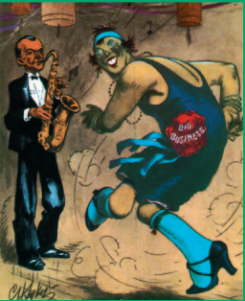
The 1920’s

Slide 102
The 1920’s
This 1920’s political cartoon depicts President Calvin Coolidge playing a saxophone labeled “praise” while a women/flapper representing “big business” dances up a storm. The cartoon suggests a cozy close relationship between the president and big business. Coolidge caters to big business, and business dances to his tune.

Slide 103
The 1920’s
A. What does this cartoon tell you about the Coolidge administration and big business?
B. The dancing women is a 1920’s “flapper”- independent, confident, and assertive. In what ways was big business in the 1920’s comparable to the flappers?

Slide 104
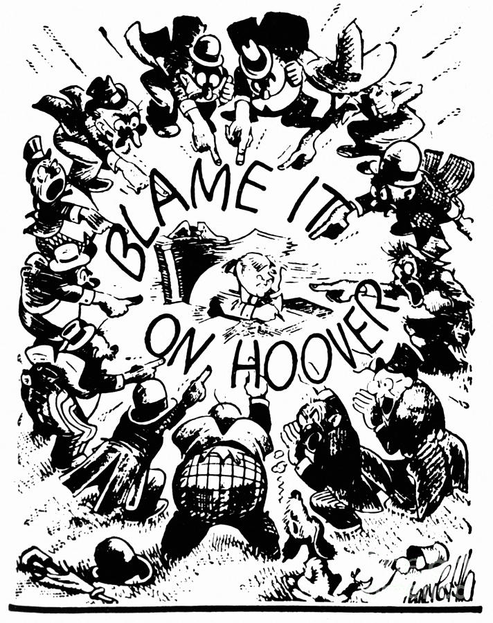
The 1930’s

Slide 105
The 1930’s
Hebert Hoover was blamed for the great depression because of his lack of involvement and issue with the stock market. He took out his money from the stocks which feared Americans currently invested in the stock market, so they pulled their money out as well, this decreased the value of stocks greatly. Also, when the great depression struck, Hoover decided not to give government aid to the people believing that it would inflate the Federal government budget. Later on though, Hoover decided to take action and try to get America out of this depression. In this cartoon, various segments of American society point their fingers at a beleaguered President Hoover.

Slide 106
The 1930’s
A. What does the cartoon suggest about Hoover’s chances for re-election in 1932?
Explain.

Slide 107
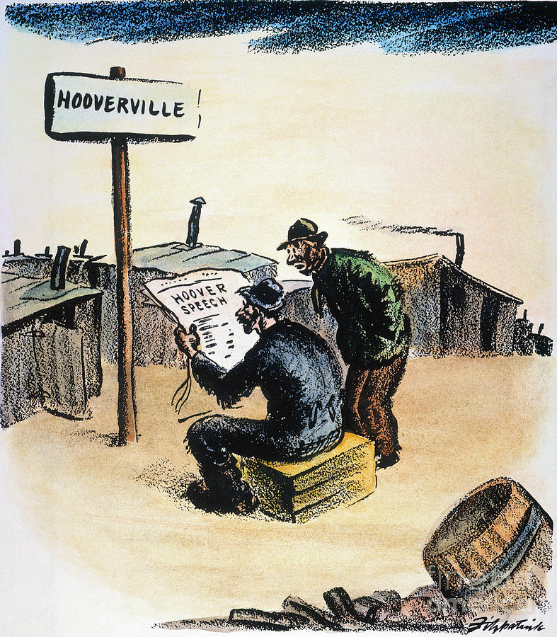
The 1930’s

Slide 108
The 1930’s
Hoovervilles were named after President Herbert Hoover during the Great Depression. The term was used to describe makeshift shantytowns set up by homeless people who nowhere else to live.
This cartoon about Hoovervilles was published in the St. Louis Post Newspaper with the headline “Hoover Speech”. It pokes fun about the fact that Hoover did not acknowledge that there were Hoovervilles across the U.S. that received little to no help. Instead the speech said that America was approaching its highest point of prosperity.

Slide 109
The 1930’s
Create and answer (4) four questions for this political cartoon.
A.
B.
C.
D.

Slide 110
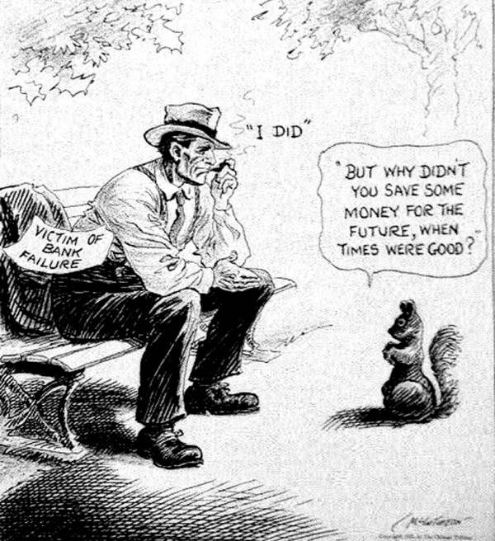
The 1930’s

Slide 111
The 1930’s
This cartoon, “A Wise Economist Asks a Question” was created by Pulitzer Prize winning cartoonist John McCutcheon in 1932.The cartoon depicts a man who did not save money but blew it all on the stock market. He is being question by a squirrel as to his decision. The cartoon being printed at the beginning of the Great Depression, is capturing the economic turmoil facing the country. It simultaneously reprimands and sympathizes with the men and women who lost their money in the stock market crash. People would see this cartoon and cartoons like it on the front page of newspapers. This cartoon really speaks to the real cause of the Depression, careless spending. By understanding the causes of the Great Depression and the situation that many Americans found themselves in, one can see how it would affect a person from that time period seeing it.

Slide 112
The 1930’s
The “Wise Economist” in this cartoon is a squirrel, representing how the wise man would store money for a darker future when he had the ability, as a squirrel does with nuts. The man is meant to represent all those impacted by the bank failures. This being a cartoon for the masses, the Chicago Tribune would want to play to their sympathies. Those who were hurt by the stock market crash would have seen this and been reminded how they should not have invested what they couldn't have lost. The reason behind this material is to make the American public see the error of their ways, and in the future become more fiscally responsible. It was the perfect time to display this message to the people. It was years after the collapse, but before Franklin Roosevelt got going as president with his new deal. Its message is a strong reminder to be responsible, so that in hard times, you don't have to deal with your mistakes.

Slide 113
The 1930’s
A. Who does the man on the park bench represent?
B. What does the man’s location (the fact that he is sitting on a park bench) add to the cartoon?
C. Why did the cartoonist choose a squirrel for this cartoon?

Slide 114
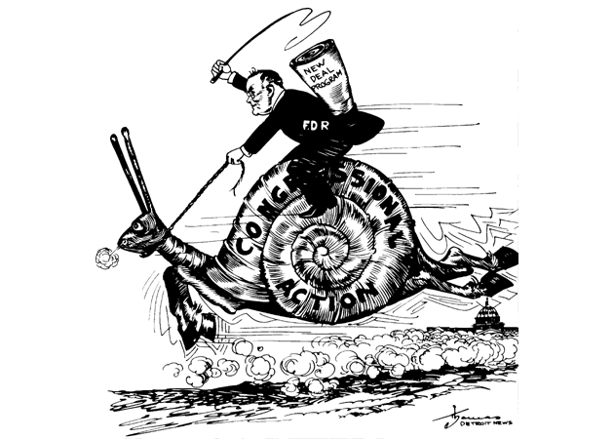
The 1930’s

Slide 115
The 1930’s
The political cartoon titled “The Galloping Snail” represents the relationship between President Franklin D. Roosevelt and Congress during FDR’s first hundred days in office. During that time period FDR pushed 15 New Deal bills through Congress which gave Americans immediate relief by providing jobs or making loans to people. Other programs supported long-term economic recovery. FDR also established the FDIC and SEC, which reformed banks and the stock market.

Slide 116
The 1930’s
A. Which branch of the U.S. government does the snail represent?
B. Why did the cartoonist use a snail to represent this branch of government?
C. What is the cartoonist saying about the relationship between the President and Congress?

Slide 117
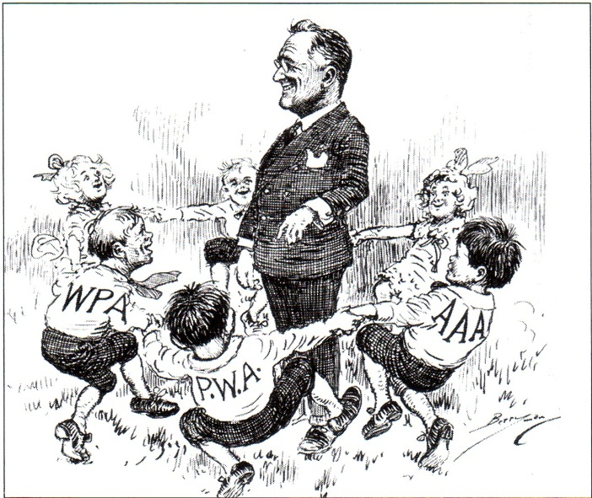
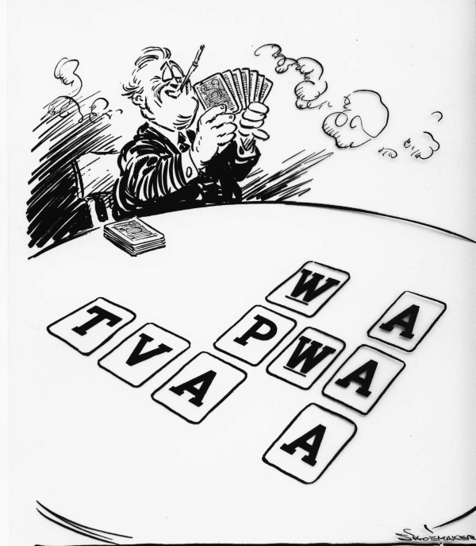
The 1930’s

Slide 118
The 1930’s
The New Deal period was characterized by intense government action on the national level. The "alphabet agencies," such as the CCC (Civilian Conservation Corps), the TVA (Tennessee Valley Authority), the WPA (Works Progress Administration), the AAA (Agricultural Adjustment Administration), and the NRA (National Recovery Administration), aimed to relieve poverty and economic distress of farmers, homeowners, businesses, laborers, and banks. These programs dramatically enlarged the power of the federal government, and though the states administered many of the programs, the tilt toward national power was clearly reinforced by the New Deal.

Slide 119
The 1930’s
What did the following government agencies and programs do during the Great Depression?
WPA-
REA-
NYA-
TVA-
CCC-
CWA-
PWA-
FERA-
FDIC-
SEC-
AAA-

Slide 120
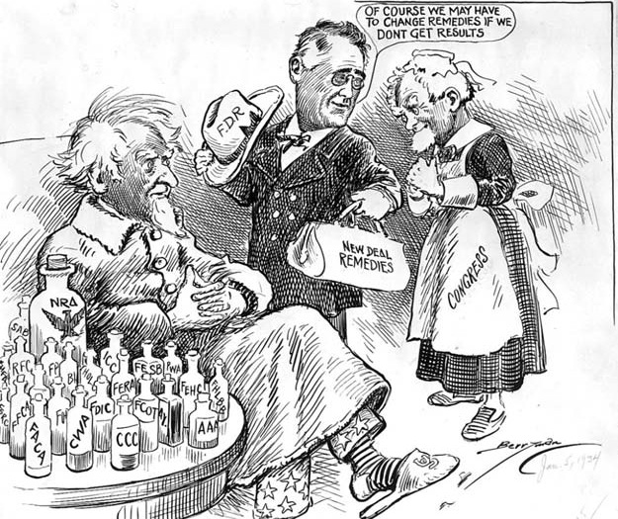
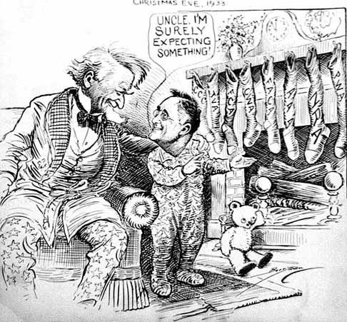
The 1930’s

Slide 121
The 1930’s
In this political cartoon, there are three important figures: President Franklin D. Roosevelt, Congress, and Uncle Sam. Each of them assumes a role in the cartoon, with FDR as the doctor, Congress as the caretaker, and Uncle Sam as the patient. Uncle Sam represents a sickly America. FDR is the doctor, who has the responsibility to cure or relieve the symptoms of the depression that struck America and its people. FDR gives Uncle Sam many different kinds of “medicine,” including programs like the National Industry Recovery Act, the Civil Works Administration, and the Agricultural Adjustment Act. In addition, FDR is carrying a bag of New Deal “remedies,” which can provide even more relief for America. FDR reassures Congress that the “remedies” do not necessarily guarantee success and changes can be made. At the time, FDR approved and passed many legislative bills, in hopes to fix America. Many people doubted whether these programs would actually help or even make things worse. This political cartoon supports FDR and his policies and puts the New Deal in a positive light. This is because Uncle Sam is shown to be in good spirits, after trying the New Deal medicines. Additionally, the cartoon depicts FDR as a man, who seems to be understanding, because he knows that the programs might not work and has a bag of solutions prepared.

Slide 122
The 1930’s
The artist was trying to convey the message that FDR wanted to get many different things done in a short period of time. He also leans toward the idea that it isn’t possible to get such a massive amount of relief and legislation passed that quickly. In order for it to be done you would need “magic” or some other worldly force. This is shown by the iconic image of a child putting out a stocking over the fireplace at Christmas in the hopes for some treat to be delivered by Santa overnight. On the stockings themselves, are many different agencies that FDR created to provide jobs, such as the: CCC, TVA, FCA, TWA etc. It can be interpreted that these programs were the primary ideas to get America back on its feet. The “gifts” that would be received would hopefully make everything return to normal, and get America back to its former glory. FDR is the child and he seems to be reassuring “Uncle Sam” that everything will be okay in the end because his New Deal will work.

Slide 123
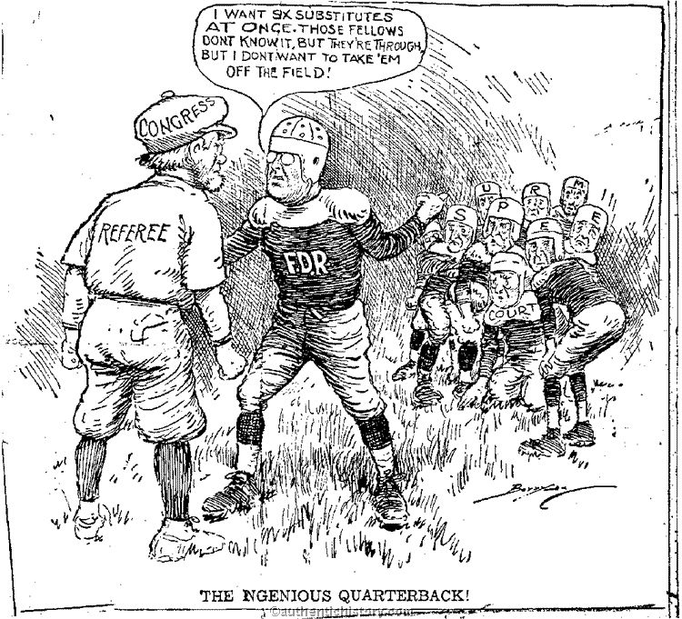
The 1930’s

Slide 124
The 1930’s
This 1937 cartoon makes fun of FDR’s court-packing plan. In the cartoon called “The Ngenious Quarterback”, the cartoonist uses a football metaphor. The quarterback is getting ready to run his next play. FDR is the quarterback, Congress is the referee, and the Supreme Court is the team. FDR says that the players on the field are through (the justices are too old), but he doesn’t want to take them off the field, instead, his idea is to ask the referee (Congress) for six substitutes (6 new Supreme Court justices). Congress would be able to supply these substitutes by passing the bill to reorganize the judiciary.

Slide 125
The 1930’s
A. Why did the cartoonist make FDR the quarterback and Congress the referee?
B. What is the cartoonist’s message

Slide 126
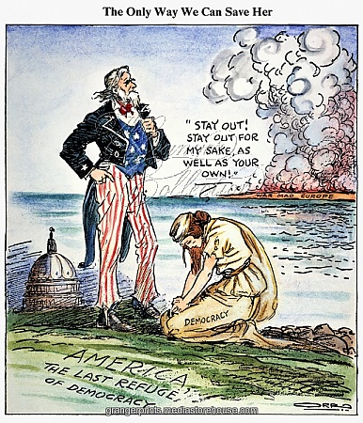
World War II

Slide 127
World War II
In this political cartoon called “The Only Way to Save Democracy”, a figure symbolizing democracy begs Uncle Sam to stay out of the war in Europe.

Slide 128
The 1930’s
A. What does this cartoonist think has happen to democracy in Europe?
B. According to this cartoonist’s vision, how will the United States be able to save democracy?
C. What symbols do you see in the cartoon?

Slide 129
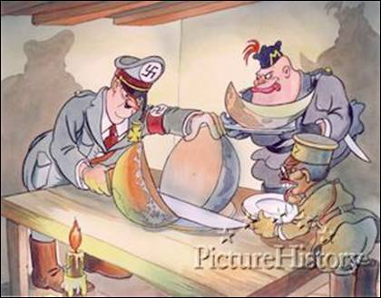
World War II

Slide 130
World War II
This political cartoon mocks the intentions of the Axis powers during World War II, and shows Adolph Hitler cutting the world into pieces like a cantaloupe to share with Hirohito and Mussolini.

Slide 131
World War II
A. What were the Axis leaders-Hitler, Mussolini, and Tojo- greedily gobbling up?
B. What nation is Hitler the leader of? What nation is Mussolini the leader of ?

Slide 132
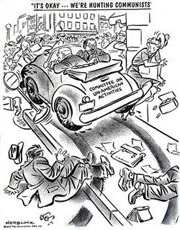
The 1940’s & the 1950’s

Slide 133
The 1940’s & the 1950’s
Editorial cartoon showing an automobile, "Committee on Un-American Activities", recklessly driven by J. Parnell Thomas, as he runs over pedestrians on the sidewalk, the passenger in the car turns to reassure the injured that "it's okay [because] we're hunting communists." He is accompanied by fellow committee member Robert E. Stripling. This cartoon was published after a week of testimony by Hollywood screenwriters that included: Ring Lardner, Jr., Lester Cole, Berthold Brecht, and John Howard Lawson, better known as part of the “Hollywood Ten”.

Slide 134
The 1940’ & the 1950’s
A. What does this cartoon imply about the methods and tactics of the HUAC?

Slide 135
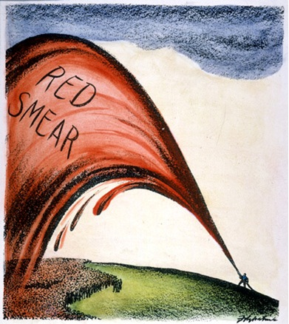
The 1940’s & the 1950’s

Slide 136
The 1950’s
The political cartoon “Red Smear” appeared in 1949, when government officials were prosecuting communists and others for subversive activities. The cartoonist’s is depicting that the search for communists was indiscriminate and unfair and that anyone might be accused.

Slide 137
The 1950’s
A. What is the cartoonist’s attitude toward the attempt to uncover communists?
B. How do you think President Truman might have responded to this cartoon?

Slide 138
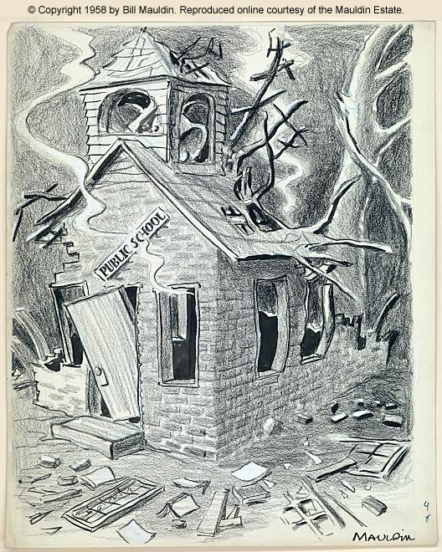
The1950’s

Slide 139
Civil Rights
In this drawing, political cartoonist Bill Mauldin commented on the actions of Little Rock to establish private schools to circumvent the U.S. 8th Circuit Court of Appeals' November 10, 1958, order to integrate. He used the dilapidated schoolhouse as a metaphor for the disintegration of public school systems in the 1950s.

Slide 140
Civil Rights
A. Why did the White citizens of Little Rock establish private schools across the city in 1958?
B. Why did it take a federal court order to integrate the public schools in Little Rock?
C. What does the dilapidated schoolhouse building represent?

Slide 141
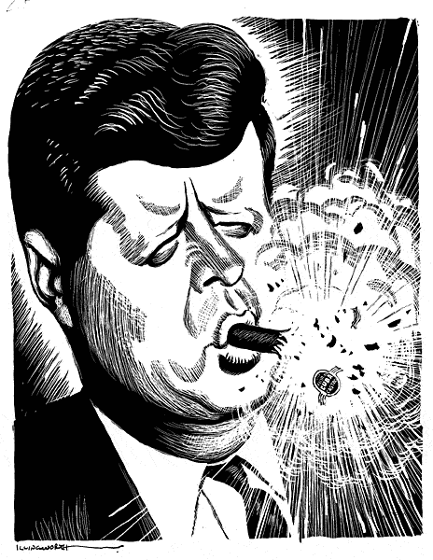
The1960’s

Slide 142
The 1960’s
The political cartoon above depicts the outcome of the Bay of Pigs Invasion in 1961. The United States sent Cuban exiles to the southern coast of Cuba for a CIA planned invasion. The hope was that Cuban’s living on the island would rise up and overthrow Castro and his communist government. This did not happen for several reasons. Instead the failed invasion blew up in Kennedy’s face. The exploding cigar is a reference to one of America’s ways to attempt to assassinate Castro by putting an explosive in his cigar.

Slide 143
The 1960’s
A. What is the purpose of the cigar?
B. How do you think Americans viewed Kennedy after this failed invasion? What about the world?
C. What was the cartoonist purpose in making this political cartoon?

Slide 144
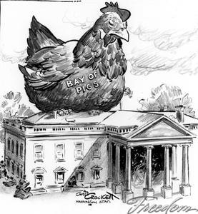
The1960’s

Slide 145
The 1960’s
This political cartoon depicts a large rooster that represents the Bay of Pigs invasion sitting atop the White House. The author of the cartoon is making the statement that John F. Kennedy's Bay of Pigs invasion has literally "come home to roost." The tone of this cartoon is almost one of ridicule, as the oversized rooster representing JFK's botched invasion is absurd and out of place, which seems to be similar to the way the artist feels about the invasion itself. The audience for this particular cartoon would be others who are also displeased about what occurred, and the purpose is to put emphasis on the president's political misstep.

Slide 146
The 1960’s
The Bay of Pigs invasion did not serve to garner much support for former president Kennedy, to say the least. It also became a detrimental factor during the Cuban Missile Crisis, as it made Kennedy appear like a fool to the international community, namely the USSR, who was not so much of a threat. In addition, the failed invasion aided Castro's position of allying with the USSR, cutting ties with the US, and embracing a new communist government.

Slide 147
The 1960’s
A. Do you think there is any symbolism in the way the objects are placed? Explain.
B. What is the artist purpose of including a giant chicken?
C. What does the cartoon suggest about the remainder of Kennedy’s presidency?
D. Do you think the Bay of Pigs played a role in the current relationship between Cuba and the U.S.? Explain.

Slide 148
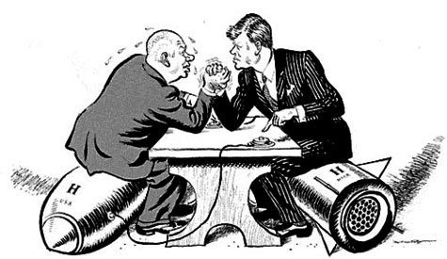
The1960’s

Slide 149
The 1960’s
This cartoon was published in 1962 at the time of the Cuban missile crisis. The USA had missiles trained on the USSR while the USSR was putting missiles on Cuba which threatened America. Each side was seen to be testing the other and Kennedy threatened to use nuclear weapons if the missiles were not removed from the island of Cuba.

Slide 150
The 1960’s
The cartoon shows Khrushchev and Kennedy arm wrestling. This is to represent the trial of strength or testing of each other’s resolve. Both are shown sitting on bombs with Kennedy clearly shown as ready to press the button to fire the bomb that is under Khrushchev. In the background Khrushchev also is ready to press his button. Kennedy is in the stronger position and Khrushchev is shown as sweating more heavily which represents concern and worry about Kennedy’s actions.’

Slide 151
The 1960’s
Create and answer (4) four questions for this political cartoon.
A.
B.
C.
D.

Slide 152
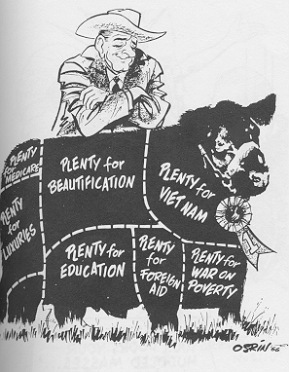
The1960’s

Slide 153
The 1960’s
This political cartoon shows President Lyndon B. Johnson with his prize cow (United States). The cow is split into different sections. Each section shows were federal money was going to be spent during the Johnson administration. One key area was LBJ's Great Society which offered many programs to fight his declared “War on Poverty”. As of today, some of the Great Society programs are still up and running. These include Job Corps which gave men and women from ages 16 to 24, the help they need to find a job or get started on a career. Also Project Headstart which is a program to give young children (whose families live in low income areas) the ability to get a headstart in school before other children their age. The Great Society also created Medicare and Medicaid. The first of the Great Society acts was the Civil Rights Act of 1964 which prohibited discrimination due to religion, race, or origin.

Slide 154
The 1960’s
A. Who was Lyndon Johnson (LBJ)?
B. What does LBJ’s prize cow represent?
C. What are some of the things that LBJ plans to use tax payer’s money on?

Slide 155

The1960’s

Slide 156
The 1960’s
The U.S. began bombing Vietnam in 1965 in efforts to get North Vietnam to speak of peace. This idea didn’t work out because the Vietnamese didn’t back down. This led the U.S. to increase the amount of bombings to try to force a compromise. U.S. officials promised that increased bombing would bring America closer to victory.
During the war Hawks believed that American involvement in the war was helping contain communism. Doves believed that the conflict was a localized civil war in which U.S. troops should not be involved.

Slide 157
The 1960’s
A. Does the emotion on the person’s face suggest that the plan is working? Explain?
B. Do you think the cartoonist was a hawk or a dove? Explain?

Slide 158

The1970’s

Slide 159
Watergate
During the Watergate hearing a bomb shell exploded when it was revealed that President Nixon secretly tape-recorded all conversations in the oval office. Although Nixon hope the tapes would one day help historians document the triumphs of his presidency, they were used to confirm his guilt.

Slide 160
Watergate
A. What was significant about the revelation that Nixon taped his conversations?
B. What does this cartoon imply about privacy during the Nixon administration?
C. What building has been transformed into a giant tape recorder?

Slide 161

The1970’s

Slide 162

Watergate
This political cartoon refers to Nixon’s taped conversations in the White House, most of which are in the Oval Office. In one of his many press conferences concerning his possible profit from public service, President Nixon declared, “I am not a crook.” However, this cartoon of him tampering with the tapes proves otherwise and reveals the truth. The tapes hold substantial evidence needed by investigators of the Watergate case because they prove Nixon’s involvement. Nixon refused to turn over these crucial tapes to detectives until he was forced to do so by the Supreme Court. While listening to the tapes, investigators found that about 18 and a half minutes missing.

Slide 163
Watergate
This political cartoon refers to Nixon’s taped conversations in the White House, most of which are in the Oval Office. In one of his many press conferences concerning his possible profit from public service, President Nixon declared, “I am not a crook.” However, this cartoon of him tampering with the tapes proves otherwise and reveals the truth. The tapes hold substantial evidence needed by investigators of the Watergate case because they prove Nixon’s involvement. Nixon refused to turn over these crucial tapes to detectives until he was forced to do so by the Supreme Court. While listening to the tapes, investigators found that about 18 and a half minutes missing.

Slide 164
Watergate
A. What is Nixon holding on to?
B. What do the audio tapes refer to?
C. Why did the prosecutor in the case want Nixon’s tapes?
D. What is the significance of the gap in the tapes created by the loss of the “NOT” section?
E. Political cartoonists use symbolism, humor, exaggeration, and caricature to present their ideas. Which of these techniques does the cartoon use here?
F. How does the cartoonist portray Nixon’s attempts to deal with the Watergate scandal?

Slide 165

The1970’s

Slide 166
Watergate
This political cartoon alludes to the story of Pinocchio. In the original fairytale, Pinocchio’s nose would get longer the more he would lie. Hence, Nixon’s nose grew the more he lied about his corruptions and involvement in the Watergate scandal.

Slide 167
Watergate
A. Why did the cartoonist compare Nixon to Pinocchio?

Slide 168

The1980’s & 1990’s

Slide 169
The 1980’s & 1990’s
One of a new generation of Soviet leaders who ascended to power in 1980s, Mikhail S. Gorbachev implemented political and cultural reforms such as perestroika (restructuring of the Russian economy) and glasnost (new "openness"). By 1991 he faced challenges from the deteriorating Soviet economy, communist hard liners, nationalists and secessionists who desired independence for their republics. Though hard-liners staged a coup in August, 1991, and placed him under house arrest, reformers re-instated him to power within three days. The cartoon portrays a sober Gorbachev surveying the once solid official symbol of Soviet unity, the crossed hammer and sickle, now a fragmented stone ruin.

Slide 170
The 1980’s & 1990’s
A. Why does the cartoonist show the hammer and sickle broken into 15 pieces?
B. How does Gorbachev seem to feel about what has happen? Why do you think he feels this way?

Slide 171

The1980’s

Slide 172
The 1980’s
During Reagan’s first term, federal spending far outstripped federal revenue and created a huge budget deficit. In this cartoon, Reagan (with budget director David Stockman sitting beside him on the inflation stagecoach) sees something that “shouldn't be there.”
In this cartoon, President Reagan and his budget director are attempting to rein in the inflation stagecoach, when suddenly a wheel flies off.

Slide 173
The 1980’s
A. What is the meaning of the wheel flying off the stagecoach?
B. Whom do the passengers inside the stagecoach represent?
C. Besides deficits, what other economic danger is the artist pointing to?
D. What opinion is the cartoonist trying to express?

